Slide 1

The EU Artificial Intelligence Act
Impact of the AI Act on emergency services
Benoit VIVIER, Public Affairs Director, EENA

Slide 2
What are we discussing today
New EU regulation on Artificial Intelligence:
Introduction to this legislation
Will this affect public safety?
What impact for North America-based organisations?
  SDF

Slide 3

Who I am
Public Affairs Director, EENA
Follow EU policies related to emergency communications
Joined EENA in 2015
Background in EU affairs

Slide 4

Who I am not

Slide 5

Who I am not

Slide 6
Agenda
Introduction to EU Law
Introductory remarks: the EU AI Act
Practices to be banned
High-risk AI : what they are and what rules
Other provisions
Q&ASDF

Slide 7
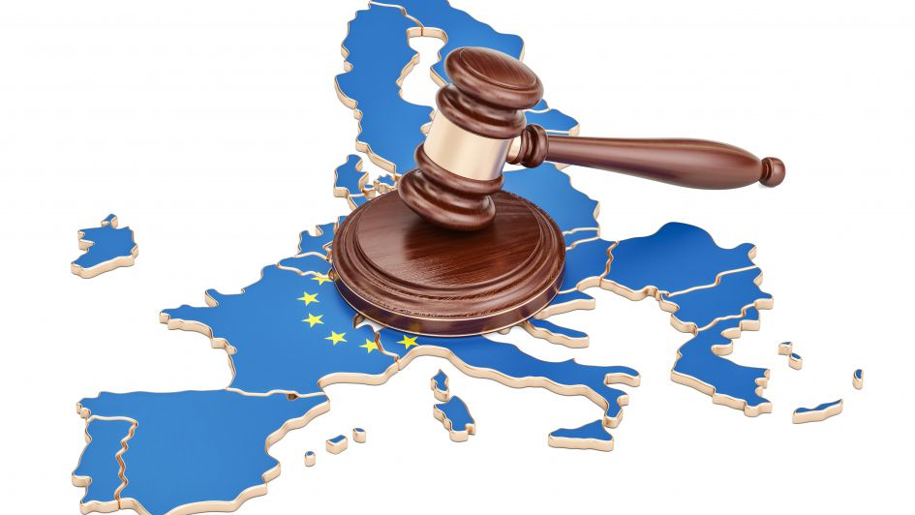
1
EU Law

Slide 8
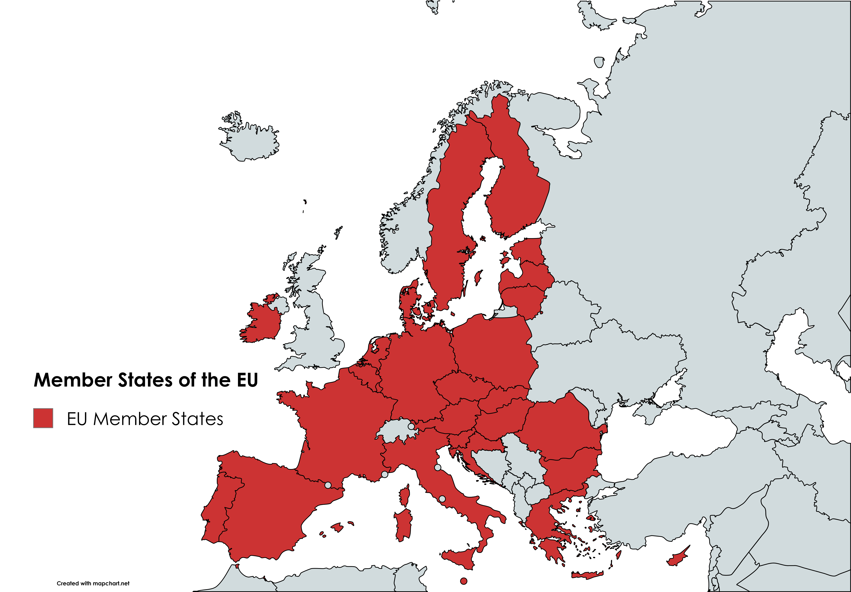
Basics of EU Law

Slide 9
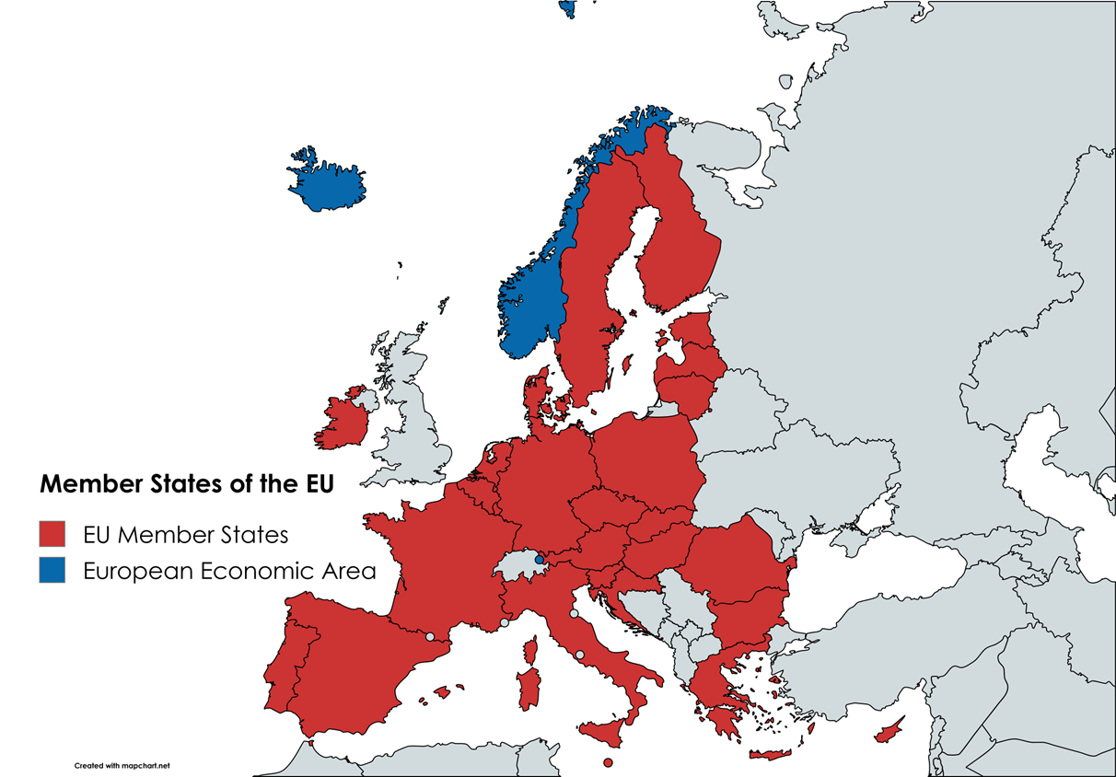
Basics of EU Law

Slide 10









Basics of EU Law

Slide 11
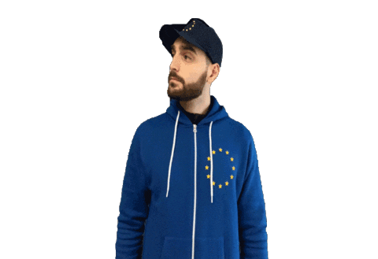
Basics of EU Law
Acts are adopted by the European Parliament (representing EU citizens) and the Council of the EU (representing Member States)
Most laws are mandatory
  Regulations: Self-executive
  Directive: Require “transposition”

Slide 12
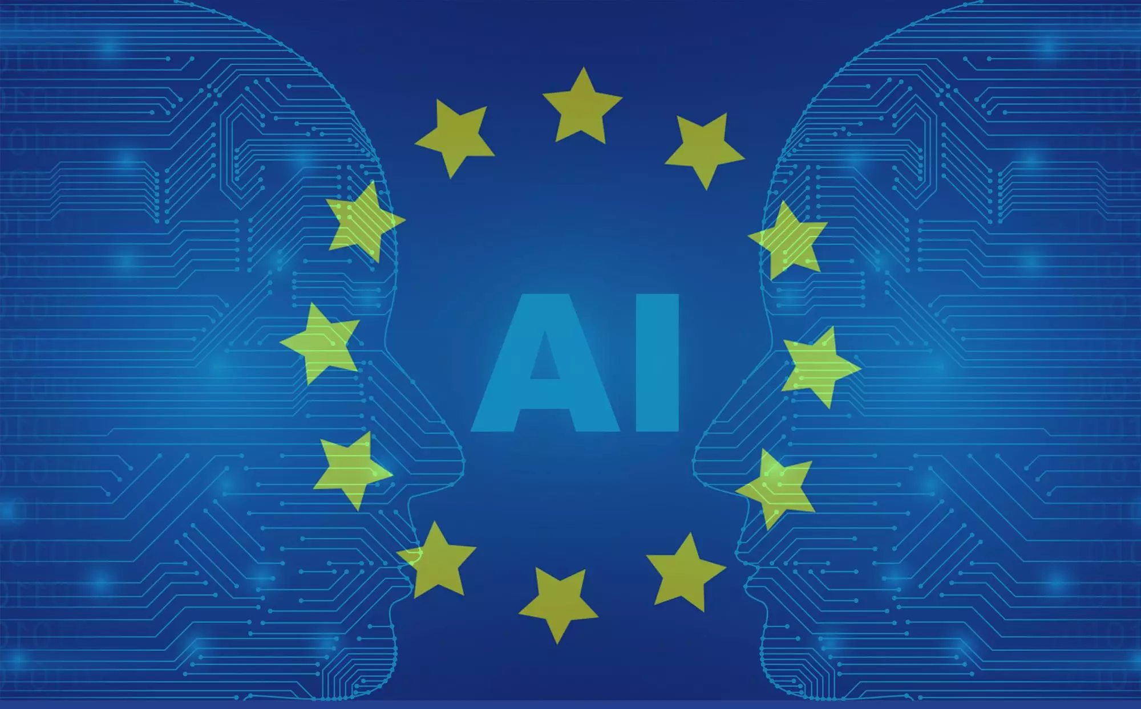
2
The EU AI Act

Slide 13
The EU AI Act: introduction
Regulation
  Binding
  Self-executive
Objectives:
  Ensure that AI systems in the EU are safe and respect fundamental rights & Union values.
  Ensure legal certainty to facilitate investment & innovation in AI
  Facilitate the development of a single market for lawful, safe and trustworthy AI applications
Entered into force in July 2024

Slide 14


Slide 15
The EU AI Act: introduction
How “AI system” is defined:
“a machine-based system designed to operate with varying levels of autonomy, that may exhibit adaptiveness after deployment and that, for explicit or implicit objectives, infers, from the input it receives, how to generate outputs such as predictions, content, recommendations, or decisions that can influence physical or virtual environments”.

Slide 16
The EU AI Act: introduction
Categories of operators of AI system:
Provider:“a natural or legal person, public authority, agency or other body that develops an AI system or a general-purpose AI model or that has an AI system or a general-purpose AI model developed and places it on the market or puts the AI system into service under its own name or trademark, whether for payment or free of charge”.
Deployer: “a natural or legal person, public authority, agency or other body using an AI system under its authority except where the AI system is used in the course of a personal non-professional activity”.
Other categories: authorised representative, importer, distributor, operator

Slide 17
The EU AI Act: introduction
Applies to:
Providers placing on the market or putting into service AI systems or placing on the market general-purpose AI models in the EU (irrespective of whether they are established in the EU or not)
Deployers of AI systems that have their place of establishment or are located within the Union;
Providers and deployers of AI systems that are located in a third country where the output produced by the system is used in the Union

Slide 18
The EU AI Act: a risk-based approach
Unacceptable risk
Prohibited
High risk
Specific requirements &
Conformity assessments
Limited risk
Specific transparency obligations
Minimal risk
Permitted with no restriction

Slide 19

3
Prohibited
AI practices

Slide 20
Prohibited AI practices:
Article 5
Placing on the market of an AI system that causes significant harm of a person
Evaluation or classification of persons based on social behaviour or characteristics ("social scoring") resulting in detrimental or unfavourable treatment
Making risk assessments of natural persons in order to assess or predict the likelihood of a natural person committing a criminal offence, based solely on the profiling of a natural person or on assessing their personality traits and characteristics
Does not apply to AI used to support the human assessment of the involvement of a person in a criminal activity.

Slide 21
Prohibited AI practices:
Article 5
AI systems that create or expand facial recognition databases through the untargeted scraping of facial images from the internet or CCTV footage
AI systems to infer emotions of a natural person in the areas of workplace and education institutions, except where the use of the AI system is intended to be put in place or into the market for medical or safety reasons
biometric categorisation systems that categorise individually natural persons based on their biometric data to deduce or infer their race, political opinions, trade union membership, religious or philosophical beliefs, sex life or sexual orientation

Slide 22
Prohibited AI practices:
Article 5
Use of real-time biometric identification systems in publicly accessible spaces for the purposes of law enforcement, unless it is stricly necessary for one of the following objectives:
  Targeted search for specific victims of abuction, trafficking in human beings or sexual exploitation of human beings, as well as searching for missing persons;
  Prevention of a specific, substantial and imminent threat to the life or physical safety of natural persons or a genuine and present or foreseeable threat of terrorist attack;
  Localisation or identification of a person suspected of having committeed a criminal offence, for the purpose of conducting a criminal investigation, prosecution or executing a criminal penalty for offences referred to in Annex II and punishable in the Member State concerned by a custodial sentence or a detention order for a maximum period of at least four years

Slide 23

4
High-risk
AI systems

Slide 24
High-risk AI systems:
List of High-risk AI systems
Biometrics
Critical infrastructure
Education and vocational training
Employment, workers management and access to self-employment
Access to and enjoyment of essential private services and public services and benefits
Law enforcement
Migration, asylum and border control management
Administration of justice and democratic processes
AI used as safety component of certain products (incl. personal protective equipment & medical devices)

Slide 25
High-risk AI systems:
List of High-risk AI systems
Biometrics
Critical infrastructure
Education and vocational training
Employment, workers management and access to self-employment
Access to and enjoyment of essential private services and public services and benefits
  d. AI systems intended to evaluate and classify emergency calls by natural persons or to be used to dispatch, or to establish priority in the dispatching of emergency first response services, including by police, firefighters and medical aid, as well as of emergency healthcare patient triage systems

Slide 26
High-risk AI systems:
List of High-risk AI systems
Biometrics
Critical infrastructure
Education and vocational training
Employment, workers management and access to self-employment
Access to and enjoyment of essential private services and public services and benefits
Law enforcement
  Assess a person’s risk of becoming the victim of a criminal offence
  Systems to be used as polygraphs
  Evaluate the reliability of evidence in the course of the investigation or prosecution of criminal offences
  Assessing the likelihood of a natural person of offending or re-offending or to assess personality traits and characteristics or past criminal behaviour of natural persons or groups
  Profiling natural persons in the course of the detection, investigation or prosecution of criminal offences

Slide 27
High-risk AI systems:
List of High-risk AI systems
Biometrics
Critical infrastructure
Education and vocational training
Employment, workers management and access to self-employment
Access to and enjoyment of essential private services and public services and benefits
Law enforcement
Migration, asylum and border control management
Administration of justice and democratic processes
AI used as safety component of certain products (incl. personal protective equipment & medical devices)
These systems will not be banned

Slide 28
High-risk AI systems:
Exemptions to High-risk AI system
AI systems should always be considered to be high-risk where AI systems perform profiling of persons.
An AI system shall not be considered to be high-risk if it does not pose a significant risk of harm to the health, safety or fundamental rights of natural persons, including by not materially influencing the outcome of decision making:
To perform a narrow procedural task
To improve the result of a previously completed human activity
Is not meant to replace or influence the previously completed human assessment, without proper human review;
Perform a preparatory task to an assessment
A provider who considers that their system meet this criterion should document its assessment.
EC to publish guidelines on the practical implementation of this.

Slide 29

High-risk AI systems:
Framework for High-risk AI systems

Slide 30
High-risk AI systems:
Framework for High-risk AI systems
Risk management plan
Data and data governance
Technical documentation
Record-keeping
Transparency and provision of information to deployers
Human oversight
Accuracy, robustness and cybersecurity

Slide 31
High-risk AI systems:
Specific obligations
Providers
  Quality Management System
  Draw up technical documentation
  Keep the logs automatically generated
  Appoint authorised representatives if in a third country
  Conformity Assessment
  EU Declaration of conformity & CE marking
  Cooperation with competent authorities
  Reporting of serious incidents to authorities
Importers
Distributors
Deployers

Slide 32
High-risk AI systems:
Specific obligations
Providers
Importers
Distributors
Deployers

Slide 33
High-risk AI systems:
Specific obligations
Providers
Importers
Distributors
Deployers
  Assign human oversight to persons who have the necessary competence, training and authority.
  Monitor the operation of the AI system
  Keep the logs automatically generated
  For high-risk AI systems that make decisions or assist in making decisions related to natural persons: shall inform the persons that they are subjected to the use of AI.
  Fundamental rights impact assessment

Slide 34

5
Other provisions

Slide 35
Other provisions
Transparency obligations
Providers AI systems intended to interact with natural persons
Providers of AI systems generating synthetic audio, image, video or text
Deployers of emotion recognition system or biometric categorisation system
Deployers of AI system that generates deep fakes
Notes:
Article 52: Providers shall ensure that AI systems intended to interact with natural persons are designed and developed in such a way that natural persons are informed that they are interacting with an AI system, unless this is obvious from the circumstances and the context of use. This obligation shall not apply to AI systems authorised by law to detect, prevent, investigate and prosecute criminal offences, unless those systems are available for the public to report a criminal offence.
Users of an emotion recognition system or a biometric categorisation system shall inform of the operation of the system the natural persons exposed thereto. This obligation shall not apply to AI systems used for biometric categorisation, which are permitted by law to detect, prevent and investigate criminal offences.
Users of an AI system that generates or manipulates image, audio or video content that appreciably resembles existing persons, objects, places or other entities or events and would falsely appear to a person to be authentic or truthful (‘deep fake’), shall disclose that the content has been artificially generated or manipulated.

Slide 36
Other provisions
Specific obligations for providers of general-purpose AI models
AI regulatory sandboxes
Establishment of EU AI Office
EU Database of High-risk AI systems
Enforcement, Information sharing & market surveillance
Codes of conduct
Notes:
controlled environment that facilitates the development, testing and validation of innovative AI systems for a limited time before their placement on the market or putting into service pursuant to a specific plan.

Slide 37
To sum up
AI is not banned
Some specific practices are prohibited
High-risk AI systems should come with specific protocols, documentation, strategies…
Transparency obligations on some types of AI

Slide 38


Slide 39


CONTACT
Benoit VIVIER
Public Affairs Director, EENA
bv@eena.org
Benoit Vivier

