Slide 1
WOMEN IN 9-1-1
WIN
A NENA ALLIANCE

Slide 2
Agenda
Mission | Vision | Objectives
About Us
Our Goal
Membership
Our board and committees
How you can help

Slide 3
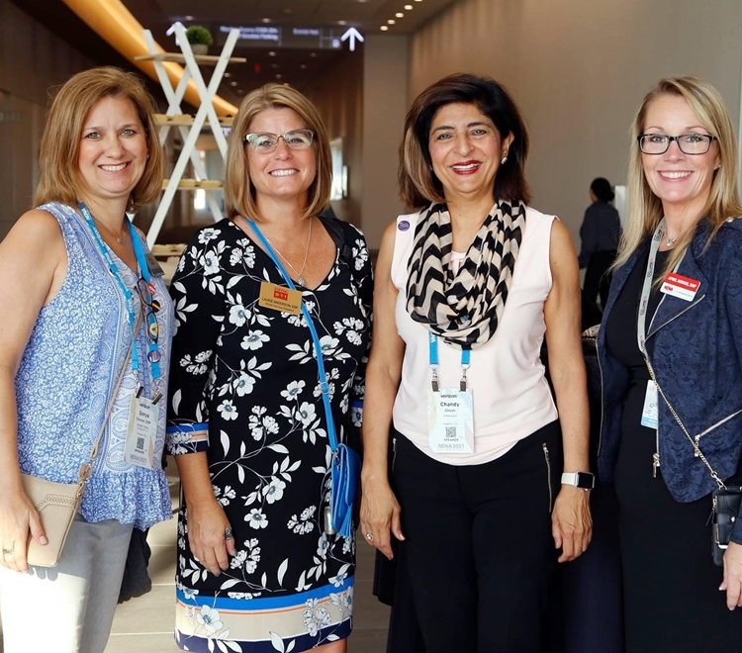
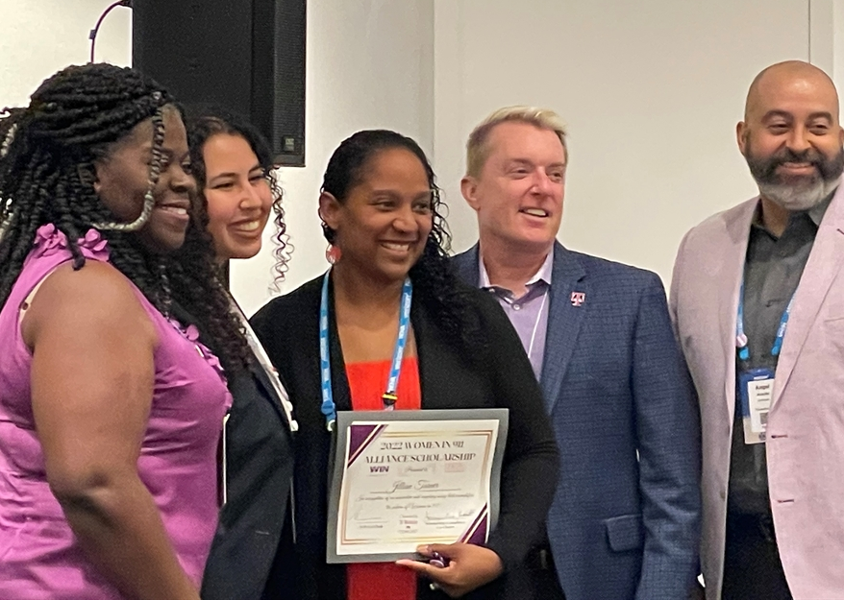
Mission
To advance women in 9-1-1 through leadership development, education, networking, and mentoring opportunities at all levels of their career.
Vision
To be the premier resource for women in 9-1-1, empowering them to reach their full potential.
Objectives
Promote achievements of Women in 9-1-1
Develop networks to harness the power of our community
Build confidence, knowledge, and leadership skills
Drive opportunities for diversity in 9-1-1
Provide mentorship and training capabilities
Share experiences and insights for growth and development
Notes:
WIN’s mission is to advance women in 9-1-1 through leadership development, education, networking, and mentoring opportunities at all levels of their career.
Our vision is to be the premier resource for women in 9-1-1, empowering them to reach their full potential.
Our objectives are to:
Promote achievements of Women in 9-1-1
Develop networks to harness the power of our community
Build confidence, knowledge, and leadership skills
Drive opportunities for diversity in 9-1-1
Provide mentorship and training capabilities
Share experiences and insights for growth and development

Slide 4
OUR GOAL IS TO GET EVERY WOMAN IN 9-1-1 TO BECOME A WIN MEMBER
About Us
OUR STORY STARTED IN 2019
WIN was founded and launched in April of 2019 by Chandy Ghosh & Monica Million.
Since the first kickoff event in June of that year, WIN has been empowering, educating, and mentoring women in the public safety communications industry for over four years.
NENA’s WIN Alliance continues to grow in numbers and state chapters are forming.
Notes:
You can help us achieve our mission by not only joining WIN yourself but encouraging other women and male allies within your organizations to sign up as well!
Invite us to present at your conferences or consider starting up a state chapter if your state doesn’t already have one. We also accept donations which will help to fund our event and support the many scholarship opportunities we provide.
Our goal is to get everyone woman in 9-1-1 to become a member and take advantage of our amazing offerings to help them grow as a leader in their careers.

Slide 5
OUR GOAL IS TO GET EVERY WOMAN IN 9-1-1 TO BECOME A WIN MEMBER
Women-Mentoring-Women
Webinars
Join WIN!
Encourage women and male-allies to sign up.
Invite WIN to present at your conferences.
Consider starting a state chapter.
Donate to WIN to help fund events and support scholarship opportunities.
Education & Scholarships
Networking Socials
Notes:
WIN was founded and launched in 2019 by Chandy Ghosh and Monica Million. WIN hosted its first event at the National NENA conference that year with great success. We continue to grow in numbers, reaching over 1,000 this year, and smaller state chapters are starting to form.
WIN’s Women-Mentoring-Women program was launched during the height of the pandemic in September of 2020. Utilizing NENA’s mentoring platform, it allows women to create a profile and choose to become a mentor, find a mentor, or both. The user can then select Woman in 9-1-1 in their area of interest and create a profile that truly reflects what they want out of the experience.
WIN hosts webinars throughout the year bringing in panelists, speakers, and presenters that are influential and well-known in the industry. All our webinars are available through our WIN page on the NENA website. Stay tuned for a QR code at the end of this presentation to take you directly to that page.
WIN provides in-person, educational sessions at national and state conferences, most notably at the annual NENA national conference. We have also published blogs and participated in podcasts to empower, uplift, and education women in 9-1-1 everywhere. Every year, in partnership with our sponsors, we offer numerous scholarships to amazing women to attend the national NENA conference.
Our networking socials hours give women an opportunity to connect, share, and experience the leaders in our industry and discover the leaders within themselves.
Our sponsors play a large role in helping us achieve each of these accomplishments and their support is much appreciated.

Slide 6
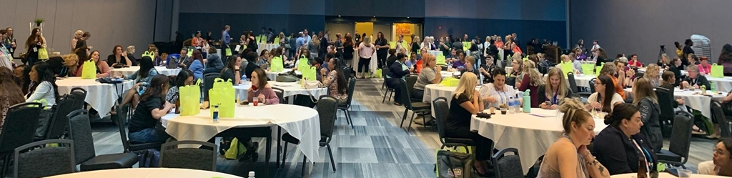
Membership
Enrollment is open to all female and male-allies who are NENA members
No additional fees for the WIN members
WIN events are open to all NENA members and non-NENA members

Slide 7
Our Board and Committees
Chairs
Advisory
Administrative
Communications & Marketing
Diva Miranda Jones
Sherri Griffith Powell
Chandy Ghosh (Chair)
Angel Arocho
Eric Hagerson
John Persano
Monica Million
Lauren Kravetz
Mage Hernandez
JoLee Chase (co-Chair)
Christina Nguyen
Rebekah Biedermann
Trisha Stojkovich
(vacant)
Sonya Lopez-Clauson (Chair)
Erica May (co-Chair)
Mag’e Hernandez
Events & Volunteers
Membership & Mentoring
Scholarships & Sponsorships
State Chapters
vacant (Chair)
Brittney Burross (co-Chair)
Candace Aldred
Kacey Leyba
Mage Hernandez
Lisa Dodson (Chair)
Courtney Doberstein (co-Chair)
Alice Johnson
JoLee Chase (Chair)
Maureen Dieckman
William Bonnano
Judith Weshinskey-Price (Chair)
Shilpa Bhanot
Ton I Dunne
Yasmin Barnett (Chair)
Lesley Musick (co-Chair)
Chandy Ghosh
Anna Marie Batt
Jeanie Pharis (Chair)
Chrissy Oldham
Myisha Callaway
Notes:
The WIN board is made up of leaders from both the public and private sector. Each committee plays an important role in helping the alliance to achieve its mission and objectives.
CHAIRS
Co-Chair Chandy Ghosh from Inteliquent, a Sinch company
Co-Chair Duana Dailey from Raleigh-Wake Emergency Communications Center in North Carolina
ADVISORY
Lynne Houserman from Motorola Solutions
Angel Arocho from Comcast
Eric Hagerson from T-Mobile
John Persano from AWS
Laurene Anderson from Charlotte County Sheriff’s Office in Florida
Monica Million from Million Consulting Services
ADMINISTRATIVE
Diva Miranda Jones from Carbyne
JoLee Chase from Dearborn County Communications in Indiana
Madison Banegas from Carteret County Communications in North Carolina
COMMUNICATIONS & MARKETING
Sonya Lopez-Clauson from Greater Harris County 911 Emergency Network in Texas.
Erica May from Memphis Police Department in Tennessee
Mag’e Hernandez from Motorola Solutions
EVENTS
Sherri Griffith Powell from Mission Critical Partners
Brittney Burros from North Central Texas Emergency Communications District in Texas
Mag’e Hernandez
VOLUNTEERS
Lisa Dodson from Motorola Solutions
Courtney Doberstein from Harrisonburg-Rockingham Emergency Communications Center in Virginia
Yasmen Barnett from RapidSOS
MEMBERSHIP
Toni Dunne from Motorola Solutions
Maureen Diekman from Moetivations
MENTORING
Toni Dunne from Motorola Solutions
Jennifer White from RapidSOS
SCHOLARSHIPS & RECOGNITION
Yasmin Barnett
Lesley Musick from Sullivan County Emergency Communications District in Tennessee
SPONSORSHIPS
Chandy Ghosh
Victoria Caylor from Whitfield County 911 in Georgia
Anna Marie Batt from NENA

Slide 8
THANKS TO OUR WIN SPONSORS !!!

Slide 9
WE WANT YOUR COMPANY TO BECOME A WIN SPONSOR!
$10,000: WIN Networking Social at NENA Annual Conference
$5,000: Networking Social at Standards & Best Practices
$5,000: Networking Social at Goes To Washington awarding Wendy Day Scholarship
$3,000: Multiple. Scholarships for a 911 Professional to attend a NENA Conference
$3,000: Multiple. Funding for in-person Speaker/Educator at a WIN NENA event
$2,000: Multiple. Entertainment for a WIN event (e.g., photobooth)
$1,000: Multiple. Excellence awards for 911 professionals
$1,000: Multiple. Funding for Webinar speakers.
$500: Multiple. Raffle prizes for events and webinars
NENA’s Women in 911 Alliance means –
Women mentoring women
Career enhancement through webinars, education, and professional networking
Scholarships for 911 professionals
Notes:
WIN was founded and launched in 2019 by Chandy Ghosh and Monica Million. WIN hosted its first event at the National NENA conference that year with great success. We continue to grow in numbers, reaching over 1,000 this year, and smaller state chapters are starting to form.
WIN’s Women-Mentoring-Women program was launched during the height of the pandemic in September of 2020. Utilizing NENA’s mentoring platform, it allows women to create a profile and choose to become a mentor, find a mentor, or both. The user can then select Woman in 9-1-1 in their area of interest and create a profile that truly reflects what they want out of the experience.
WIN hosts webinars throughout the year bringing in panelists, speakers, and presenters that are influential and well-known in the industry. All our webinars are available through our WIN page on the NENA website. Stay tuned for a QR code at the end of this presentation to take you directly to that page.
WIN provides in-person, educational sessions at national and state conferences, most notably at the annual NENA national conference. We have also published blogs and participated in podcasts to empower, uplift, and education women in 9-1-1 everywhere. Every year, in partnership with our sponsors, we offer numerous scholarships to amazing women to attend the national NENA conference.
Our networking socials hours give women an opportunity to connect, share, and experience the leaders in our industry and discover the leaders within themselves.
Our sponsors play a large role in helping us achieve each of these accomplishments and their support is much appreciated.

Slide 10
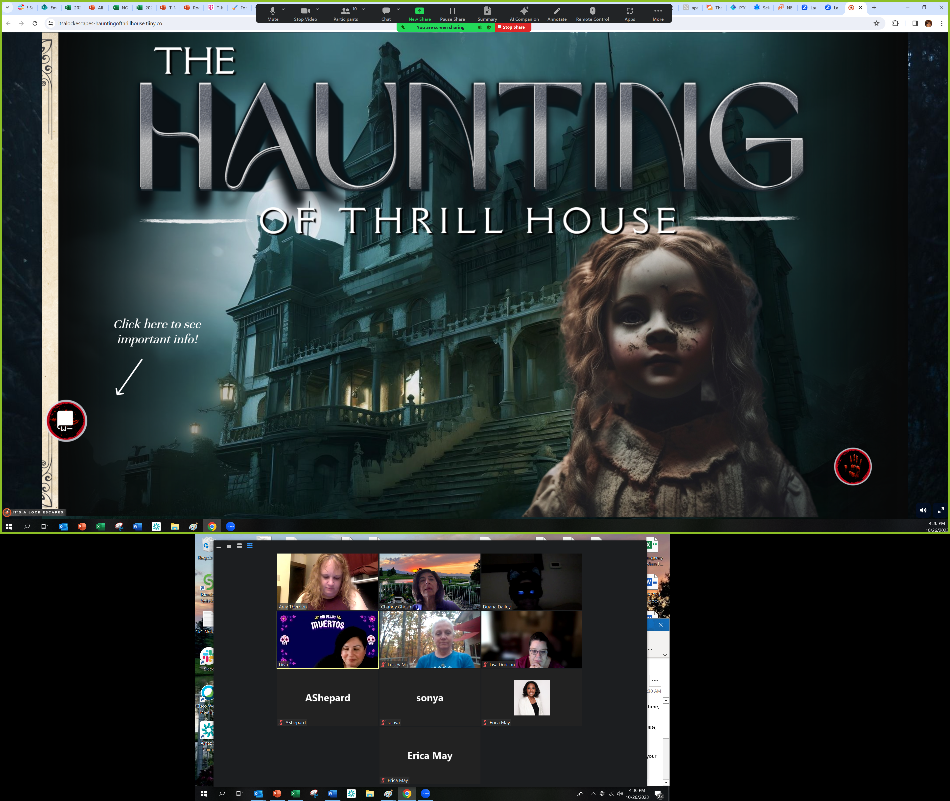
Halloween Happy Hour

Slide 11
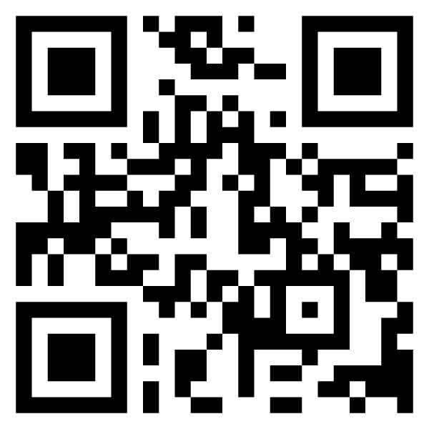
THANK YOU
#WomenIn911
Notes:
Scan the QR code to go directly to our NENA Group Page and join us now!
Also, to keep up with our activities, follow NENA on social media!

